Slide 1
进度汇报
康萌萌
2019.07.04

Slide 2
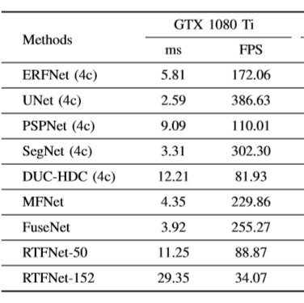
inference speed
Methods | 速度(GTX 2080Ti) |  | 性能
 | ms | FPS | mAcc | mIoU
FuseNet | 3.07 | 325.7 | 57.7 | 41.6
MFNet | 4.53 | 220.8 | 54.6 | 43.7
RTFNet(152) | 29.74 | 33.62 | 61.8 | 51.2
ours(V2) | 5.52 | 181.12 | 66.5 | 54.4

Slide 3
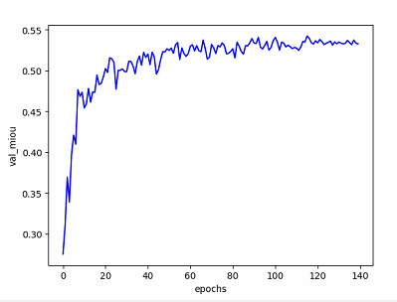
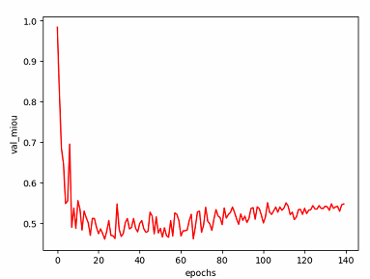
Training loss

Slide 4
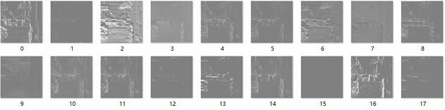
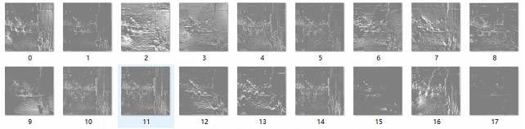
Feature maps

Slide 5
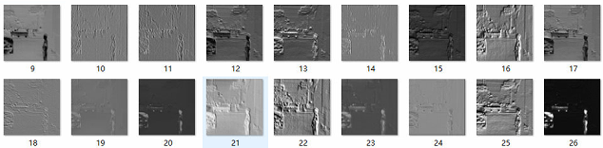
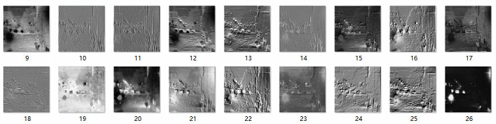
Feature maps

